Slide 1

ELEVATIONS CREDIT UNION
IST 647 | Dr.Conrad Shayo
GROUP MEMBERS
DIGVIJAY SINGH DEORA
SWAPNIL NIKAM
SHUBHANKAR JATHAR
MOHAMMED SAAD

Slide 2
Agenda
Introduction
Database Design View
User Requirement Specification Matrix
Conceptual View
Tables in SQL
SwitchBoard
Forms
Menu
Reports
Demo

Slide 3


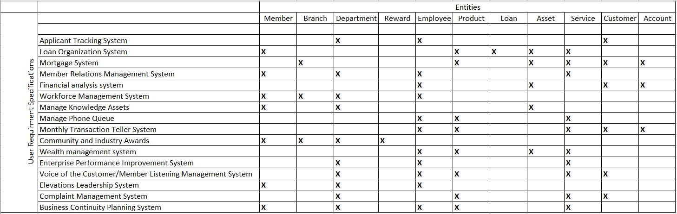
User Requirement Specification Matrix

Slide 4
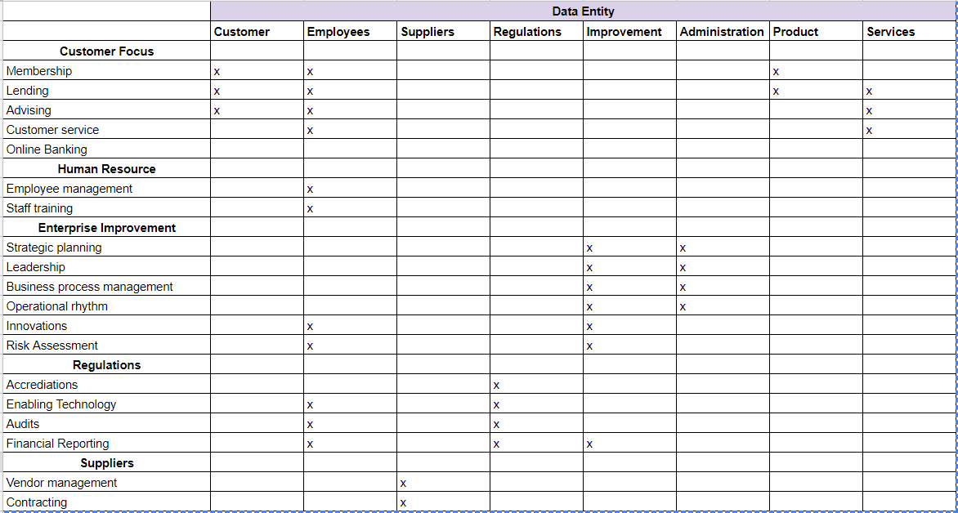
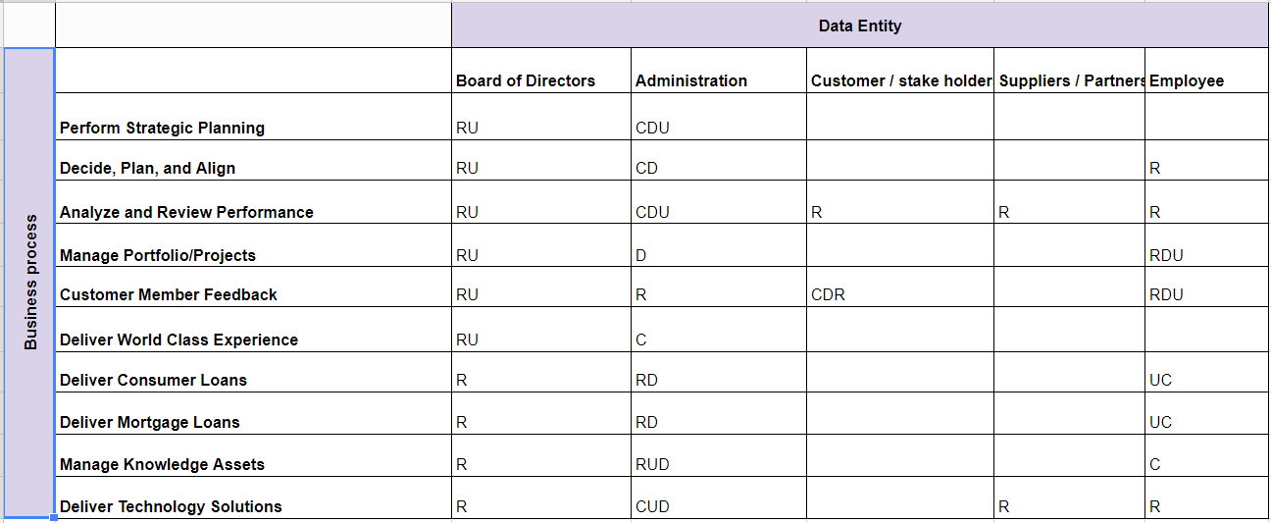
Matrices
Business Process or Use Case M Matrix
Processes & Entity Matrix

Slide 5

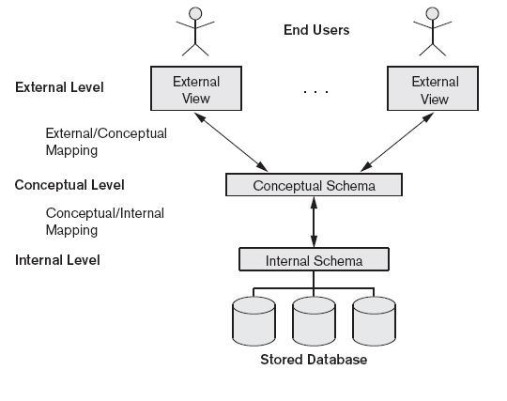
DATABASE DESIGN VIEW
External level
Conceptual Level
Internal view

Slide 6
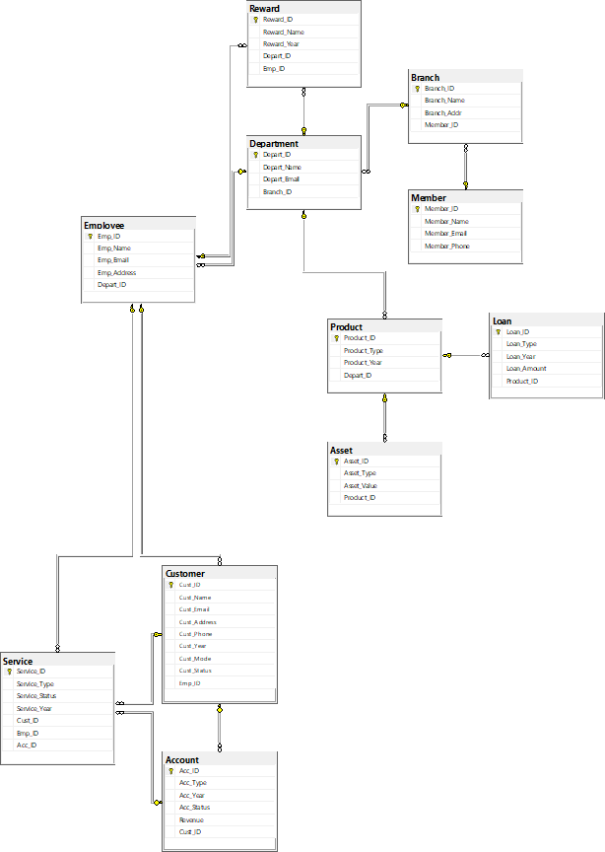
ER DIAGRAM –CONCEPTUAL VIEW
The Diagram shows the conceptual model of our database design
The Entity tables are connected in a star schema model showing all the relationships between the entities.

Slide 7
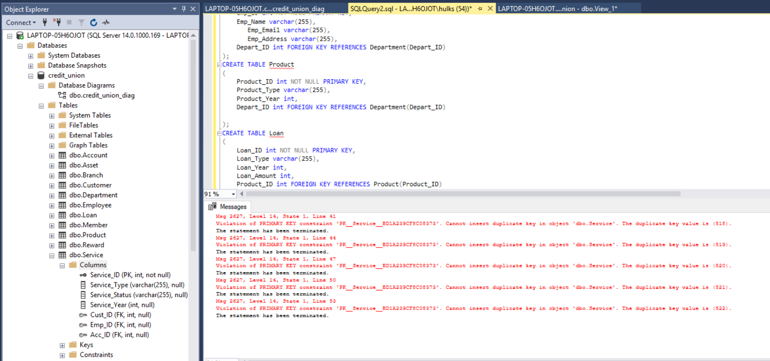
TABLES CREATED IN MS SQL

Slide 8
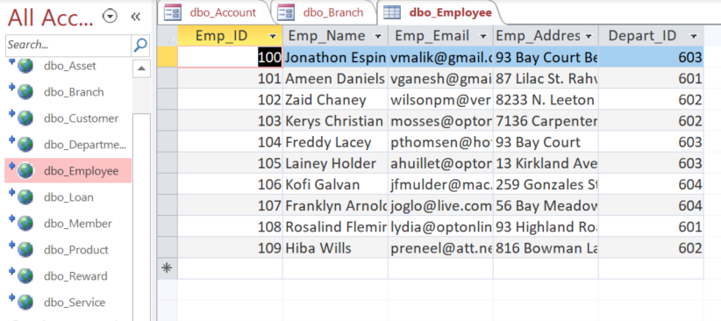
TABLES LINKED TO MS ACCESS

Slide 9
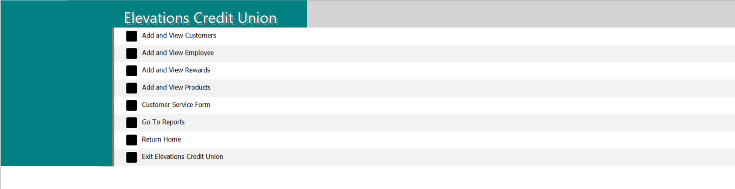
SwitchBoard

Slide 10
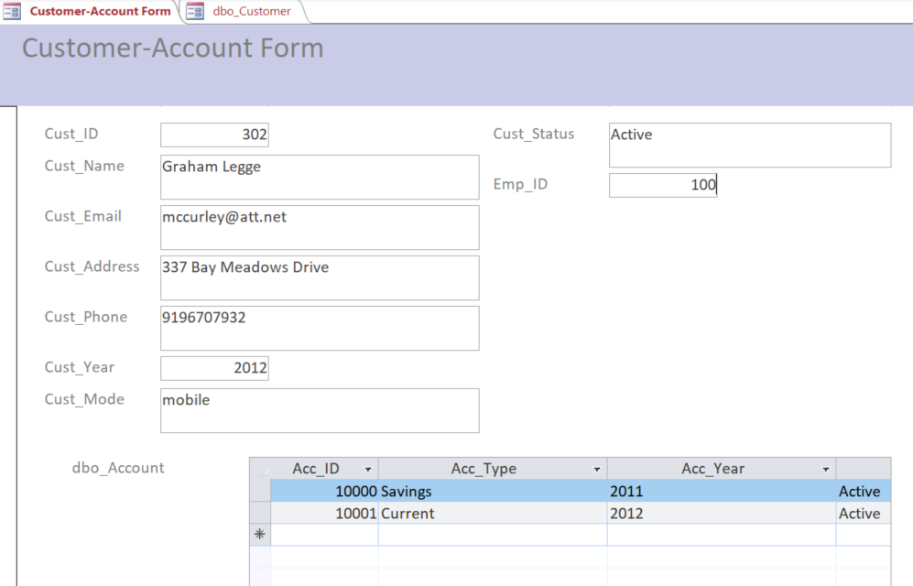
FORMS
An Example of Customer – Account Form

Slide 11
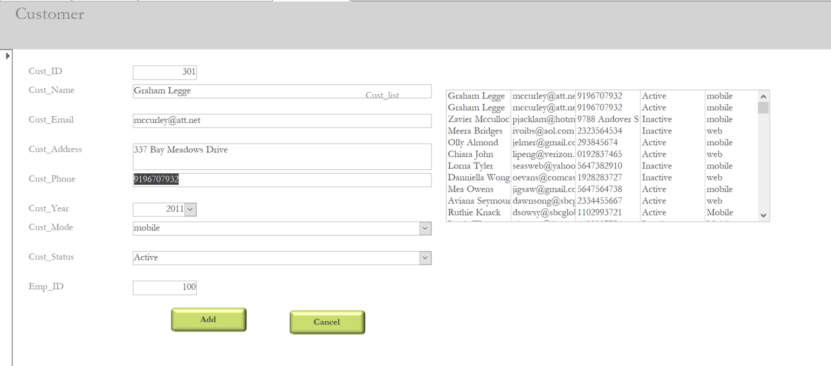
MENU

Slide 12
Reports

Slide 13
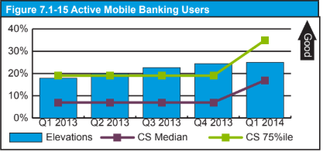
Active Mobile Banking Users

Slide 14
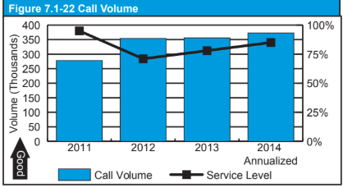
Call Volume

Slide 15
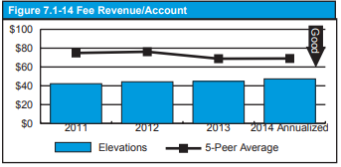
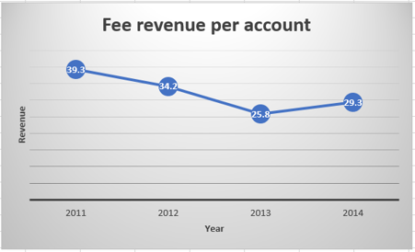
Fee Revenue Per Account

Slide 16
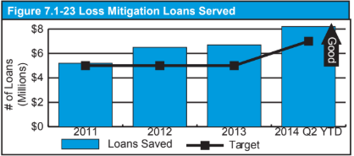
Loan Served

Slide 17
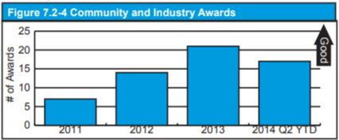
Community And Industry Awards

Slide 18
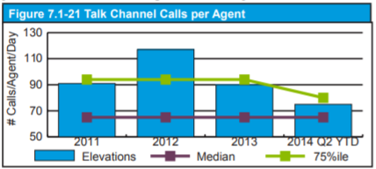
Talk Channels Calls Per Teller

Slide 19
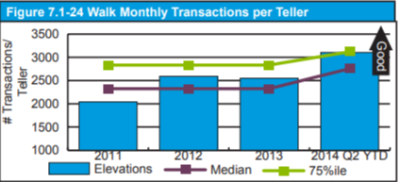
Walk Transactions Per Teller

Slide 20
Demo

Slide 21
THANK YOU

